Slide 1
Collection Framework

Slide 2
Collection Framework
Provides an architecture to store and manipulate the group of objects.
Achieve all the operations that you perform on a data such as searching, sorting, insertion, manipulation, and deletion.
Java Collection means a single unit of objects.
Java Collection framework provides many interfaces (Set, List, Queue, Deque) and classes (ArrayList, Vector, LinkedList, PriorityQueue, HashSet, LinkedHashSet, TreeSet).

Slide 3
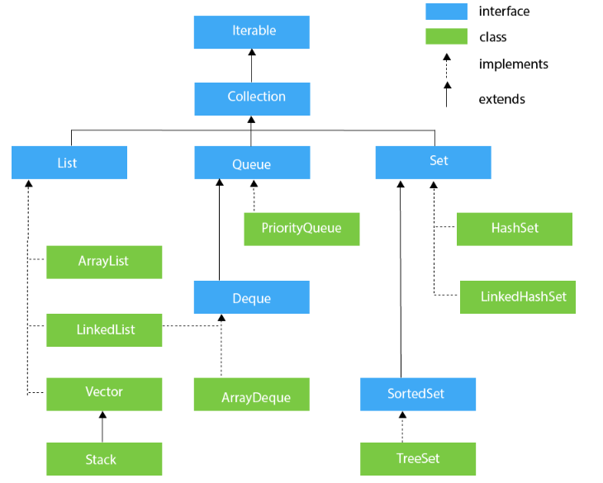

Slide 4
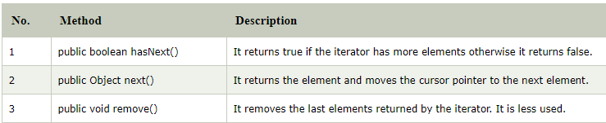
Iterator interface
Iterator interface provides the facility of iterating the elements in a forward direction only.

Slide 5
Collection Interface
Interface which is implemented by all the classes in the collection framework.
It declares the methods that every collection will have.
Collection interface builds the foundation on which the collection framework depends.
Some of the methods of Collection interface are
Boolean add ( Object obj)
Boolean addAll ( Collection c)
void clear(), etc.
which are implemented by all the subclasses of Collection interface.

Slide 6
List Interface
List interface is the child interface of Collection interface.
It inhibits a list type data structure in which we can store the ordered collection of objects.
It can have duplicate values.
List interface is implemented by the classes ArrayList, LinkedList, Vector, and Stack.
To instantiate the List interface, we must use :
List <data-type> list1= new ArrayList();
List <data-type> list2 = new LinkedList();
List <data-type> list3 = new Vector();
List <data-type> list4 = new Stack();

Slide 7
ArrayList
Java ArrayList class uses a dynamic array for storing the elements( there is no size limit)
We can add or remove elements anytime, much more flexible than the traditional array.
It is found in the java.util package.
The ArrayList in Java can have the duplicate elements also.
It implements the List interface so we can use all the methods of List interface here.
The ArrayList maintains the insertion order internally

Slide 8
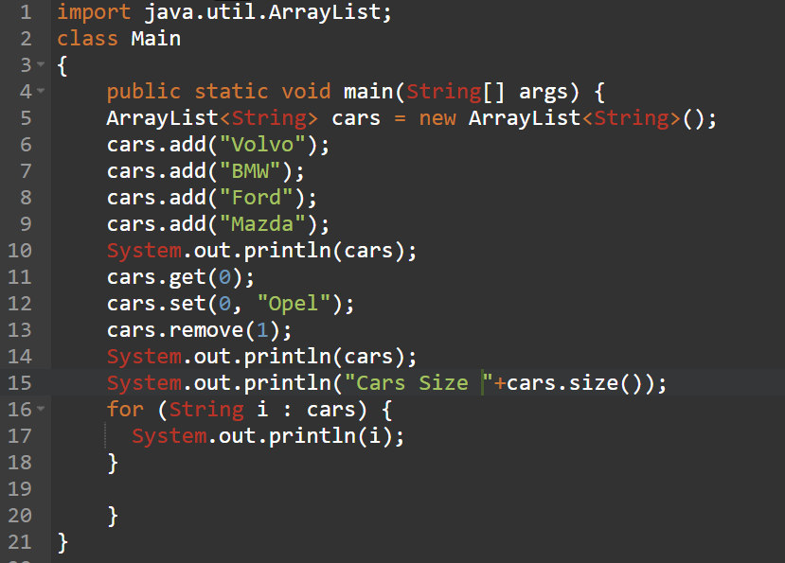
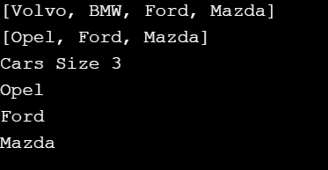
ArrayList Example

Slide 9

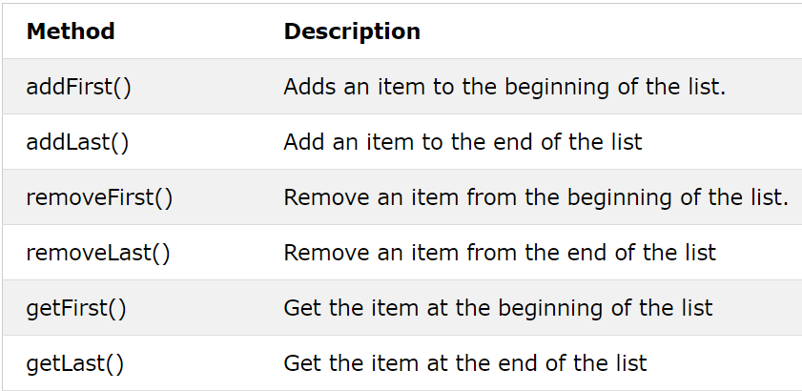
LinkedList
Java LinkedList class uses a doubly linked list to store the elements.
It provides a linked-list data structure.

Slide 10

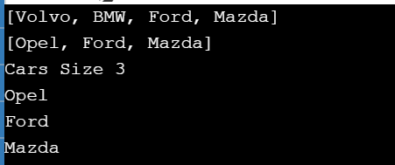
LinkedList Example

Slide 11
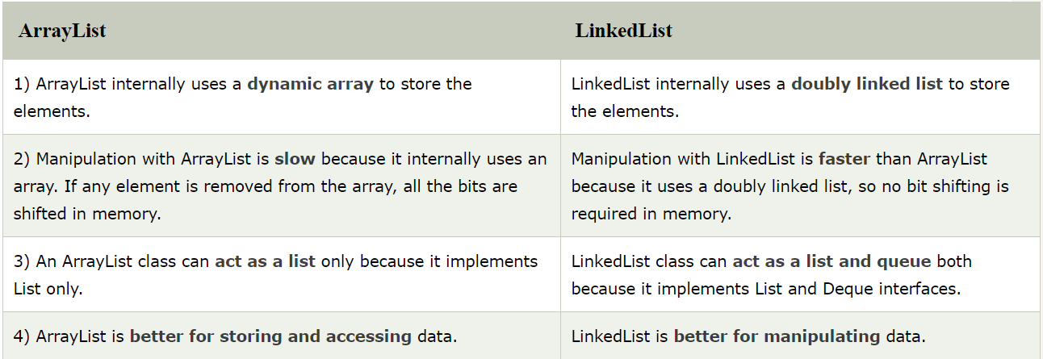
ArrayList v/s LinkedList

Slide 12
Vectors
Vector implements a dynamic array of objects.
Vector proves to be very useful if you don't know the size of the array in advance or you just need one that can change sizes over the lifetime of a program.
Vector can contain heterogeneous objects
We cannot store elements of primitive data type; first it need to be converted to objects. A vector can store any objects.
Its defined in java.util package and class member of the Java Collections Framework.
Notes:
All vectors start with an initial capacity. After this initial capacity is reached, the next time that you attempt to store an object in the vector, the vector automatically allocates space for that object plus extra room for additional objects. By allocating more than just the required memory, the vector reduces the number of allocations that must take place. This reduction is important, because allocations are costly in terms of time. The amount of extra space allocated during each reallocation is determined by the increment that you specify when you create the vector. If you don't specify an increment, the vector's size is doubled by each allocation cycle.

Slide 13
Vectors
Vector implements List Interface
A vector has an initial capacity, if this capacity is reached then size of vector automatically increases.
This default initial capacity of vectors are 10.
Each vector tries to optimize storage management by maintaining a capacity and a capacityIncrement arguments.
To traverse elements of a vector class we use Enumeration interface.

Slide 14
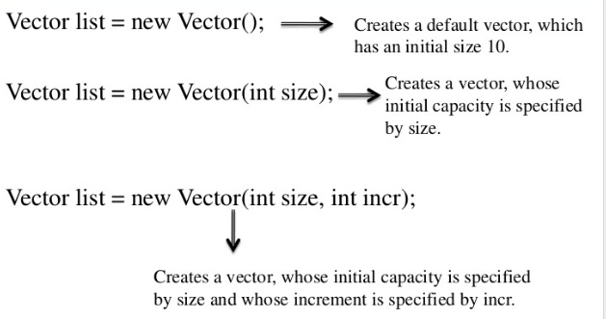
Vector Constructor and Description

Slide 15
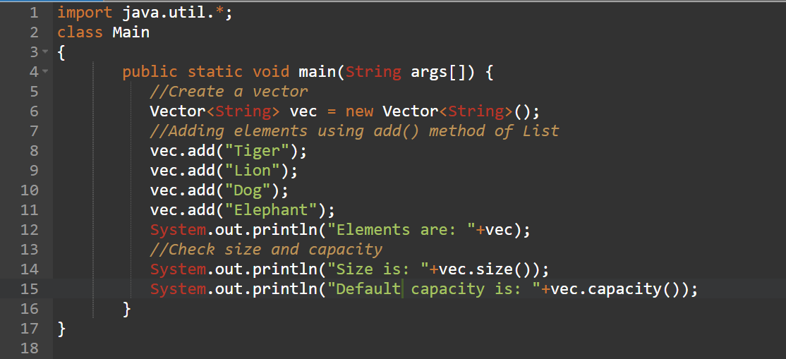
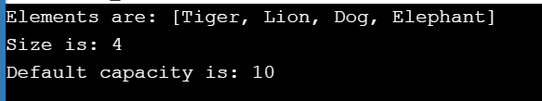
Default Vector Example

Slide 16
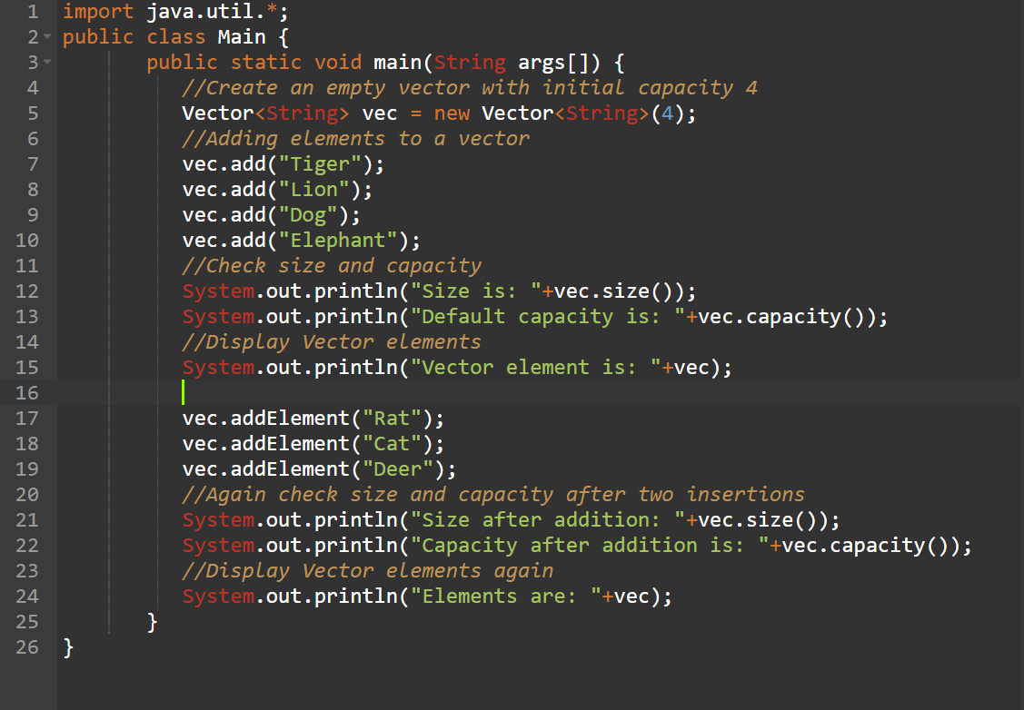
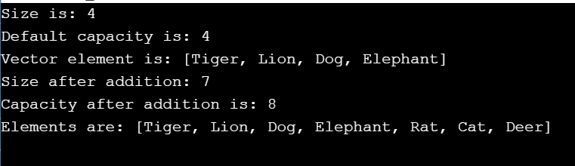
Vector with Initial Size

Slide 17
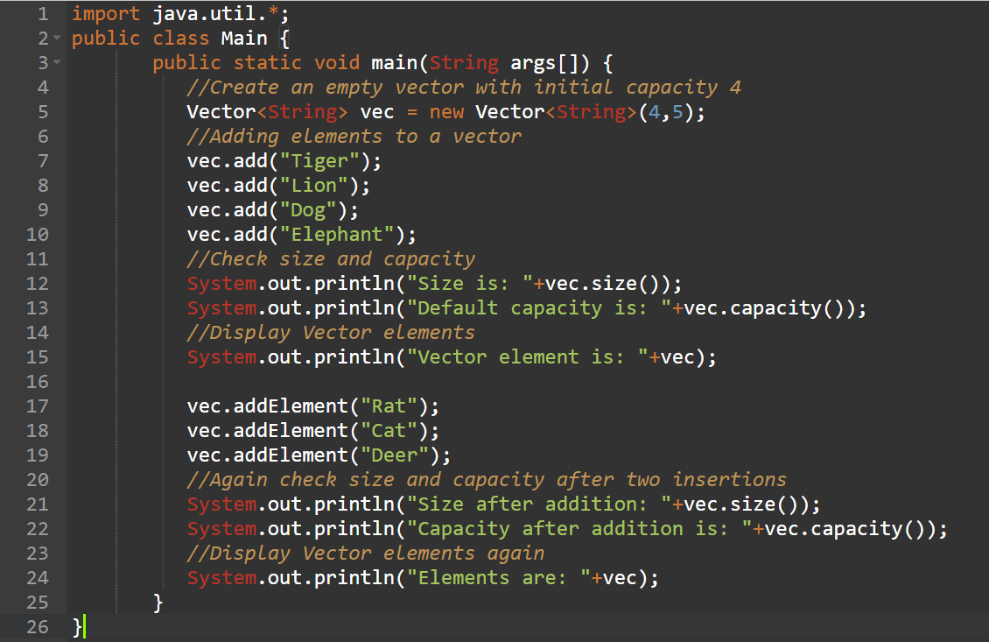
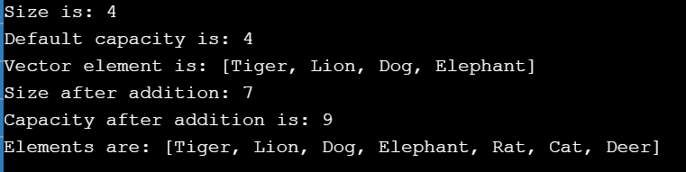
Vector with Initial Size and Increment

Slide 18
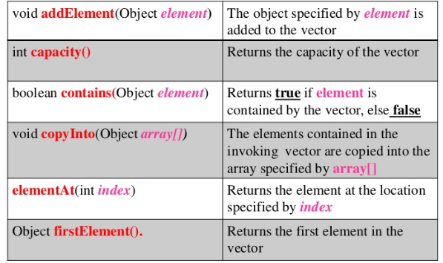
Vector Methods

Slide 19
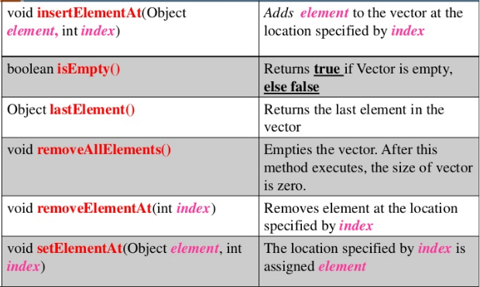
Vector Methods

Slide 20
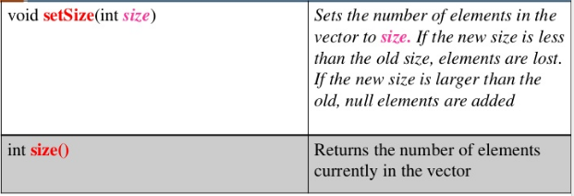
Vector Methods

Slide 21
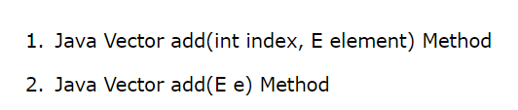
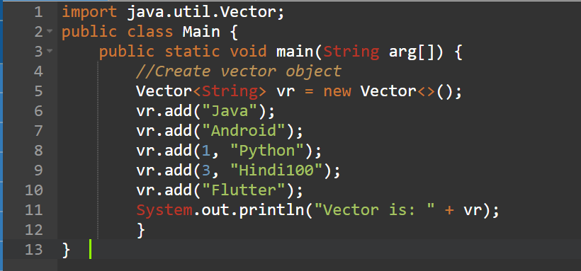
Vector add() Method

Slide 22
Example: boolean add(E e)
import java.util.Vector;
public class VectorAddExample1 {
public static void main(String arg[]) {
//Create an empty Vector with an initial capacity 5
Vector<String> vc = new Vector<String>(4);
vc.add("A");
vc.add("B");
vc.add("C");
vc.add("D");
vc.add("E");
System.out.println("Elements of Vector are");
for (String str : vc) {
System.out.println("Alphabet= " +str);
}
}
}
import java.util.*;
public class TestJavaCollection
{
public static void main(String args[]){
Vector<String> v=new Vector<String>();
v.add("Ayush");
v.add("Amit");
v.add("Ashish");
v.add("Garima");
Iterator<String> itr=v.iterator();
while(itr.hasNext()){
System.out.println(itr.next());
}
}
}

Slide 23
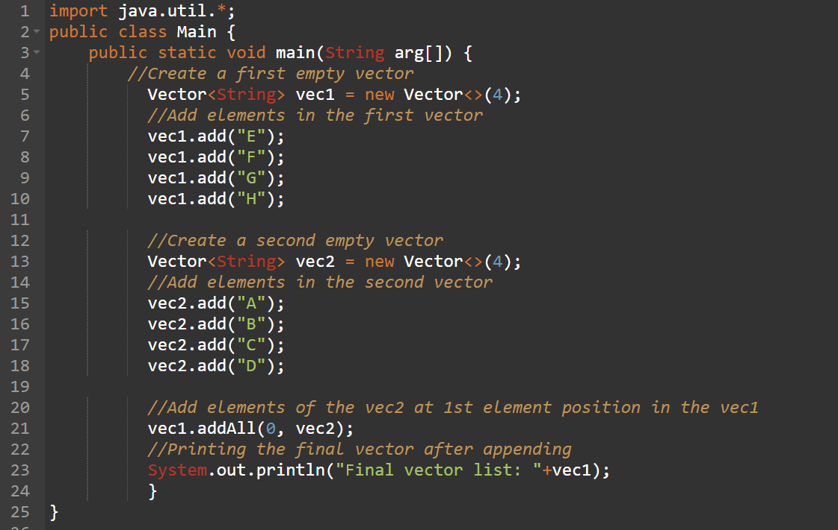
Example: boolean addAll(int index, Collection<? extends E> c)

Slide 24
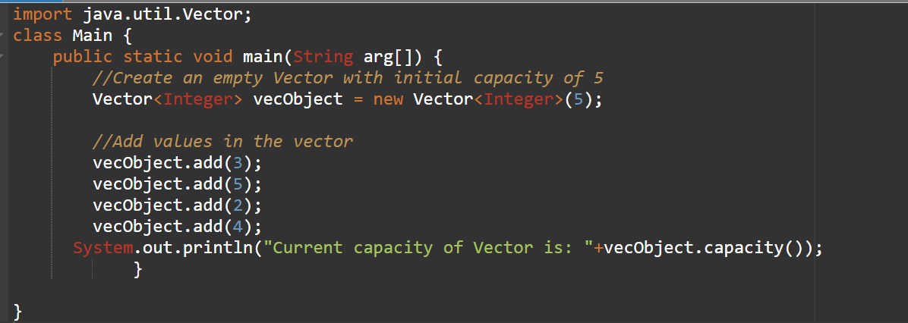

Example: int capacity()

Slide 25
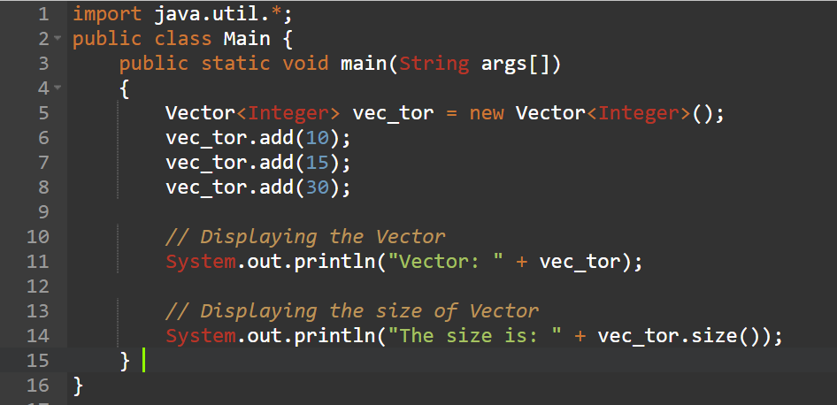
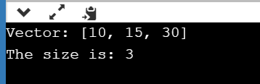
Example: int size()

Slide 26
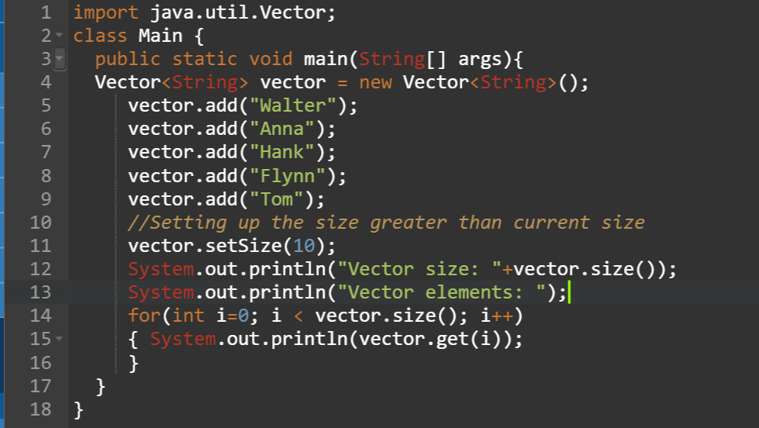
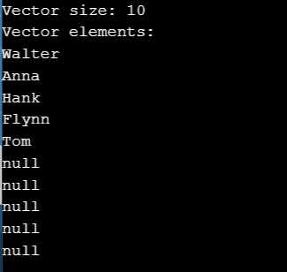
Example: void setSize(int size)

Slide 27
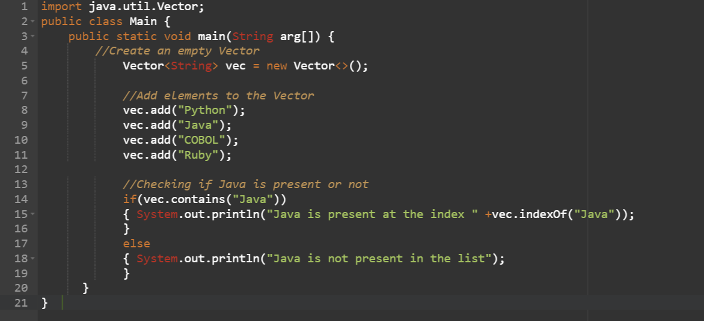

Example: boolean contains(Object o)

Slide 28
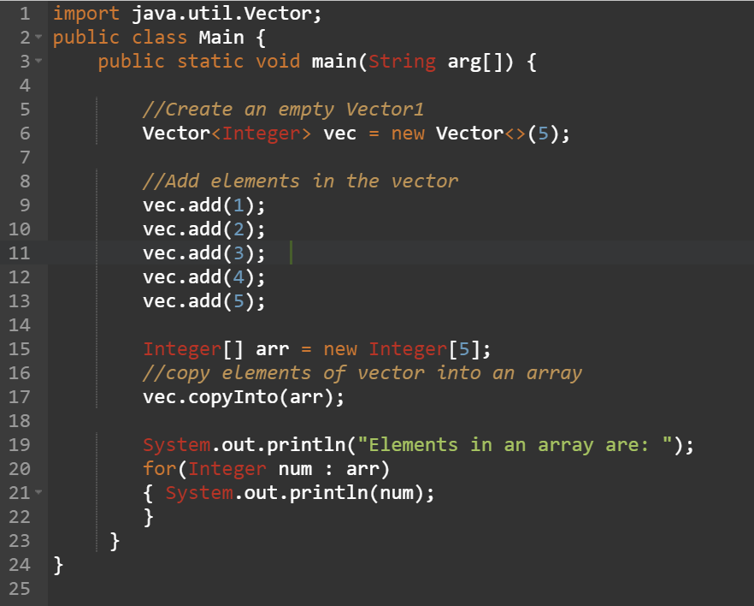
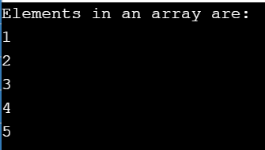
Example: void copyInto(Object[ ] anArray)

Slide 29
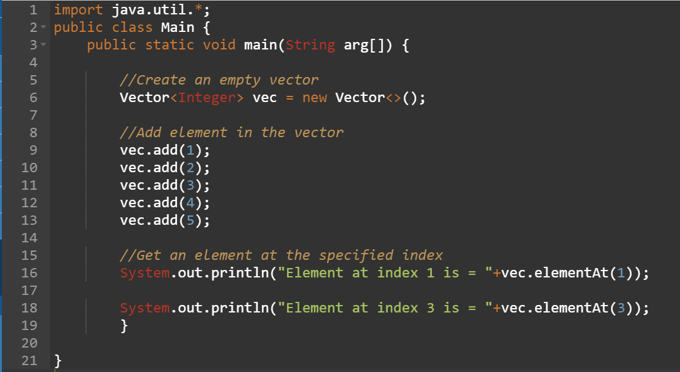

Example: E elementAt(int index)

Slide 30
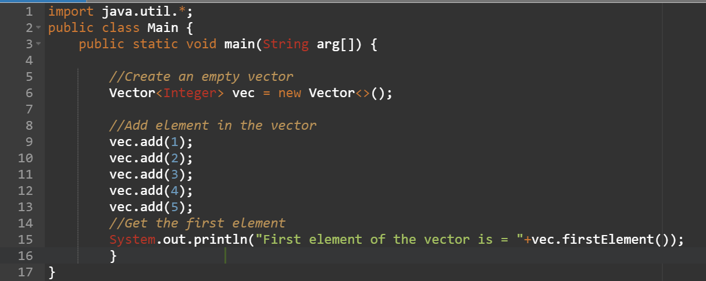
Example: E firstElement()

Slide 31
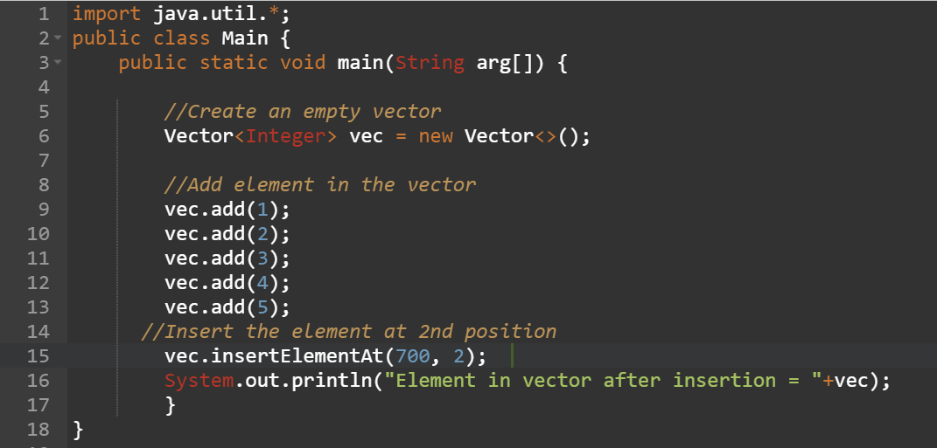
Example: void insertElementAt(E obj, int index)

Slide 32
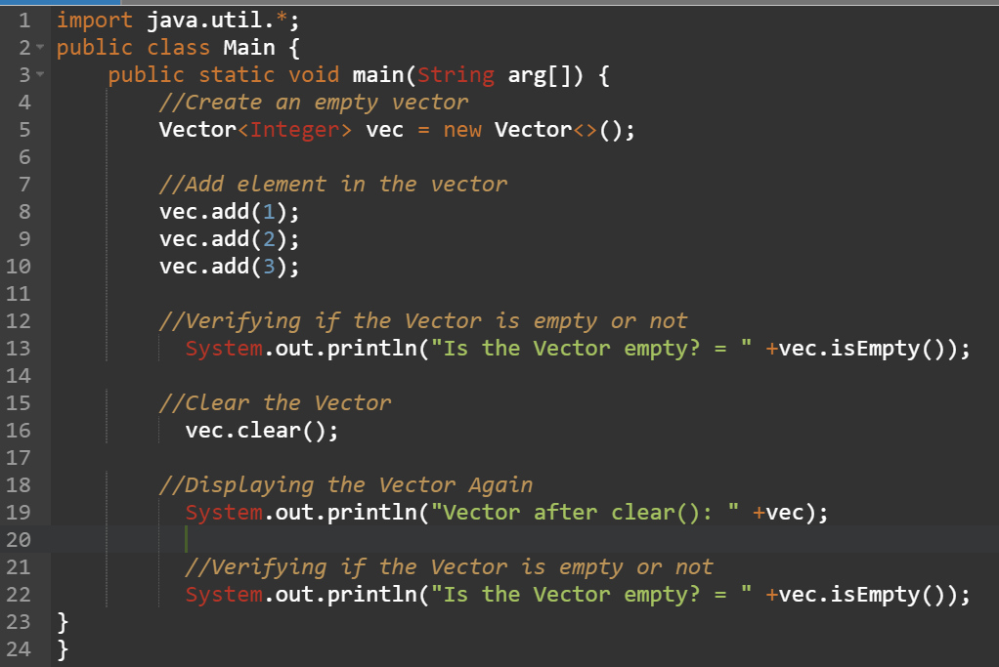

Example: boolean isEmpty()

Slide 33
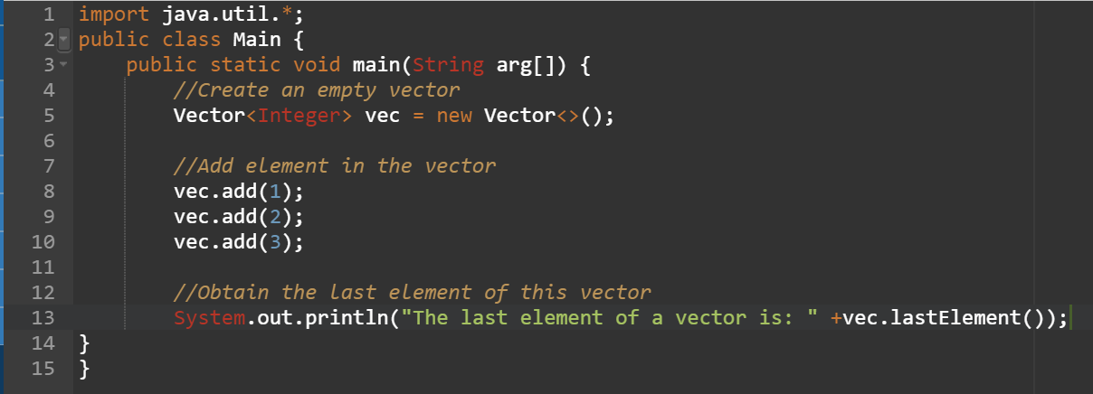

Example: E lastElement()

Slide 34
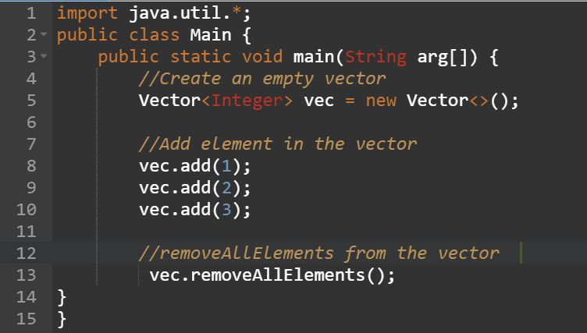
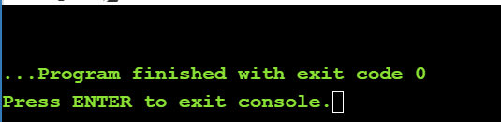
Example: void removeAllElements()

Slide 35
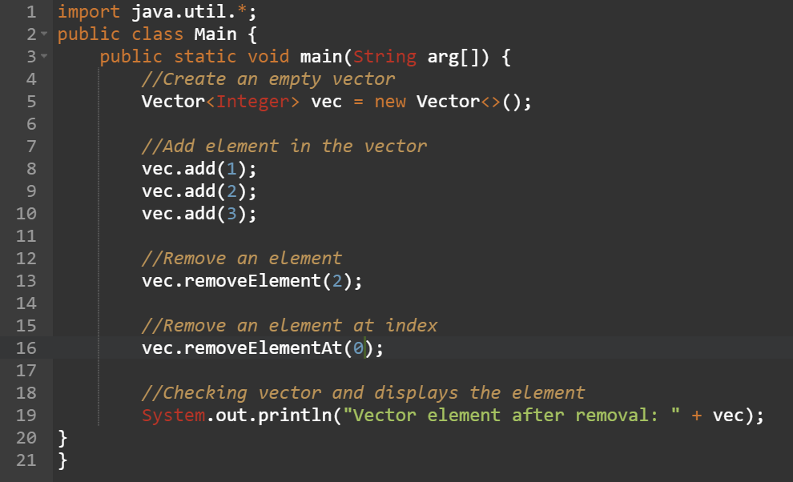
Example:void removeElementAt(int index)

Slide 36
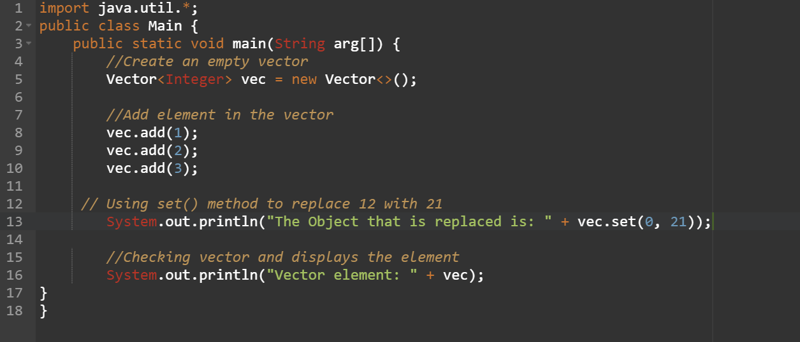

Example: E set(int index, E element)

Slide 37
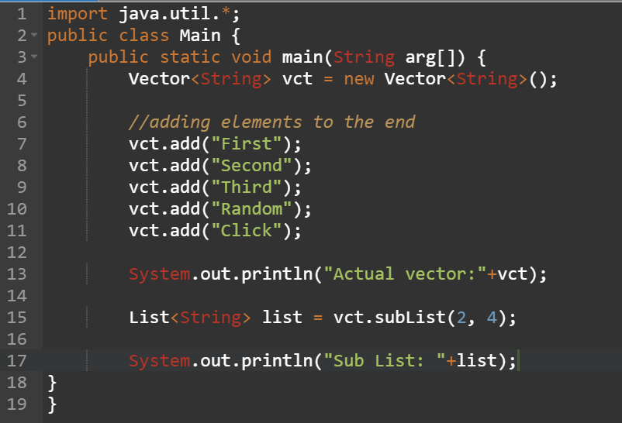
Example: sublist from vector

Slide 38
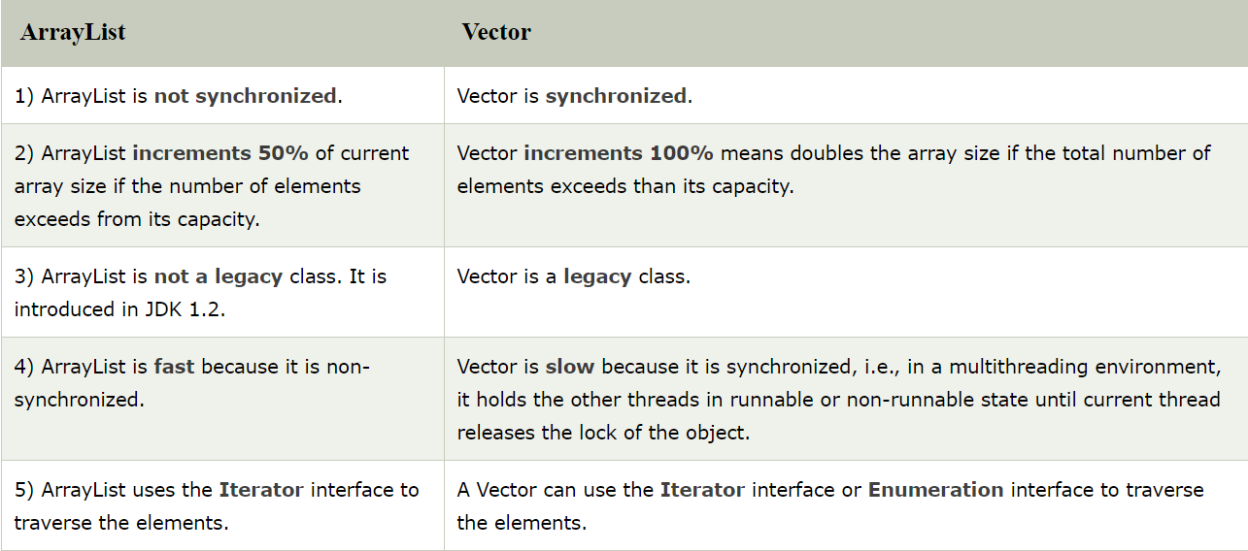
ArrayList v/s Vector

Slide 39
Assignment:1 Vectors
Write a program that accepts students names from command line and stores in vector
Set size() of student vector
Add 10 records in student vector
Print last element in vector
Insert new element at index 3
Print sublist of vector from index 4 to 8
Remove all elements from vector
Check if vector is empty()

Slide 40
Methods of Vector Class
1. boolean add(E e) This method appends the specified element to the end of this Vector.
2.void add(int index, E element) This method inserts the specified element at the specified position in this Vector.
3.boolean addAll(Collection<? extends E> c) This method appends all of the elements in the specified Collection to the end of this Vector.
4.boolean addAll(int index, Collection<? extends E> c) This method inserts all of the elements in the specified Collection into this Vector at the specified position.
5.void addElement(E obj) This method adds the specified component to the end of this vector, increasing its size by one.
6.int capacity() This method returns the current capacity of this vector.
7.void clear() This method removes all of the elements from this vector.
8.clone clone() This method returns a clone of this vector.
9.boolean contains(Object o) This method returns true if this vector contains the specified element.
10.boolean containsAll(Collection<?> c) This method returns true if this Vector contains all of the elements in the specified Collection.

Slide 41
Methods of Vector Class(Contd..)
11.void copyInto(Object[ ] anArray) This method copies the components of this vector into the specified array.
12. E elementAt(int index) This method returns the component at the specified index.
13.Enumeration<E> elements() This method returns an enumeration of the components of this vector.
14.void ensureCapacity(int minCapacity) This method increases the capacity of this vector, if necessary, to ensure that it can hold at least the number of components specified by the minimum capacity argument.
15.boolean equals(Object o) This method compares the specified Object with this Vector for equality.
16.E firstElement() This method returns the first component (the item at index 0) of this vector.
17.E get(int index) This method returns the element at the specified position in this Vector.
18int hashCode()This method returns the hash code value for this Vector.
19int indexOf(Object o)This method returns the index of the first occurrence of the specified element in this vector, or -1 if this vector does not contain the element.
20int indexOf(Object o, int index)This method returns the index of the first occurrence of the specified element in this vector, searching forwards from index, or returns -1 if the element is not found.

Slide 42
Methods of Vector Class(Contd..)
21void insertElementAt(E obj, int index)This method inserts the specified object as a component in this vector at the specified index.
22boolean isEmpty()This method tests if this vector has no components.
23E lastElement()This method returns the last component of the vector.
24int lastIndexOf(Object o)This method returns the index of the last occurrence of the specified element in this vector, or -1 if this vector does not contain the element.
25int lastIndexOf(Object o, int index) This method returns the index of the last occurrence of the specified element in this vector, searching backwards from index, or returns -1 if the element is not found.
26E remove(int index) This method removes the element at the specified position in this Vector.
27boolean remove(Object o) This method removes the first occurrence of the specified element in this Vector If the Vector does not contain the element, it is unchanged.
28boolean removeAll(Collection<?> c) This method removes from this Vector all of its elements that are contained in the specified Collection.
29void removeAllElements() This method removes all components from this vector and sets its size to zero.
30boolean removeElement(Object obj) This method removes the first occurrence of the argument from this vector.

Slide 43
Methods of Vector Class(Contd..)
31void removeElementAt(int index)This method deletes the component at the specified index.
32protected void removeRange(int fromIndex, int toIndex)This method removes from this List all of the elements whose index is between fromIndex, inclusive and toIndex, exclusive.
33boolean retainAll(Collection<?> c)This method retains only the elements in this Vector that are contained in the specified Collection.
34E set(int index, E element)This method replaces the element at the specified position in this Vector with the specified element.
35void setElementAt(E obj, int index)This method sets the component at the specified index of this vector to be the specified object.
36void setSize(int newSize)This method sets the size of this vector.
37int size()This method returns the number of components in this vector.
38List <E> subList(int fromIndex, int toIndex)This method returns a view of the portion of this List between fromIndex, inclusive, and toIndex, exclusive.
39object[ ] toArray()
This method returns an array containing all of the elements in this Vector in the correct order.

Slide 44
Methods of Vector Class(Contd..)
40<T> T[ ] toArray(T[ ] a)This method returns an array containing all of the elements in this Vector in the correct order; the runtime type of the returned array is that of the specified array.
41String toString()This method returns a string representation of this Vector, containing the String representation of each element.
42void trimToSize()This method trims the capacity of this vector to be the vector's current size.

Slide 45
Example:(2)
import java.util.*;
public class VectorDemo
{
public static void main(String args[])
{
// initial size is 3, increment is 2
Vector v = new Vector(3, 2);
System.out.println("Initial size: " + v.size());
System.out.println("Initial capacity: " + v.capacity());
v.addElement(new Integer(1));
v.addElement(new Integer(2));
v.addElement(new Integer(3));
v.addElement(new Integer(4));

Slide 46
Example:(2)
System.out.println("Capacity after four additions: " + v.capacity());
v.addElement(new Double(5.45));
System.out.println("Current capacity: " + v.capacity());
v.addElement(new Double(6.08));
System.out.println("Current capacity: " + v.capacity());
v.addElement(new Float(7.4));
System.out.println("Current capacity: " + v.capacity());
if(v.contains(new Integer(3)))
System.out.println("Vector contains 3.");
// enumerate the elements in the vector.
Enumeration vEnum = v.elements();
System.out.println("\nElements in vector:");
while(vEnum.hasMoreElements())
System.out.print(vEnum.nextElement() + " ");} }

Slide 47
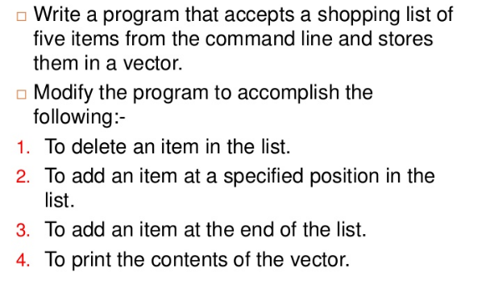
Assignment:2 Vectors

